Slide 1
Introduction to Network Security: Cryptography, Firewalls, and VPNs

Slide 2
Introduction to Network Security
Network security refers to the policies, technologies, protocols, and practices used to protect computer networks and the data transmitted through them from unauthorized access, misuse, modification, disclosure, and disruption.
Modern computer networks connect computers, servers, mobile devices, cloud platforms, and IoT devices. These connections make communication easier but also expose systems to threats such as eavesdropping, malware, identity theft, and denial-of-service attacks.
Network security aims to ensure that data is transmitted securely and that network resources remain available to authorized users.

Slide 3
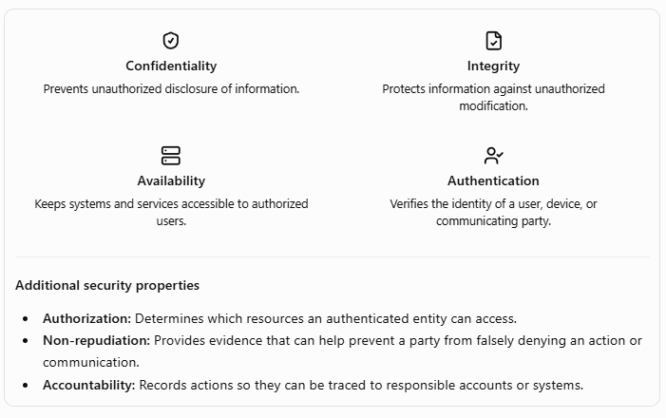
Objectives of network security

Slide 4
Common network security threats
Threat | Description | Example
Eavesdropping | Unauthorized observation of network traffic | Reading unencrypted messages over public Wi-Fi
Spoofing | Falsifying an identity or network address | A fake website impersonating a bank
Malware | Malicious software that damages, monitors, or controls systems | Ransomware spreading across a network
Man-in-the-middle (MITM) | An attacker intercepts or relays communication between parties | Intercepting an insecure connection
Denial of Service (DoS) | Making a service unavailable by exhausting resources | Flooding a server with requests
Phishing | Deceiving users into disclosing credentials or other information | A fraudulent login email
Data modification | Unauthorized alteration of transmitted information | Changing a transaction amount

Slide 5
Major network security mechanisms
Three important technologies are:
Cryptography: Protects information through encryption, hashing, and cryptographic authentication.
Firewalls: Control network traffic according to security rules.
Virtual Private Networks (VPNs): Create protected communication channels over an untrusted network.
These technologies serve different purposes and are often deployed together.

Slide 6
Cryptography
Definition
Cryptography is the science of securing information by using mathematical techniques and algorithms. It allows communicating parties to protect data even when the communication channel may be observed or attacked by unauthorized parties.
Cryptography is used in secure websites, online banking, messaging applications, digital signatures, password storage systems, and VPNs.
The main goals of cryptography include confidentiality, integrity, authentication, and support for non-repudiation.

Slide 7
Basic terminology
Term | Meaning
Plaintext | Original readable information
Ciphertext | Transformed information that is not directly readable without the appropriate decryption capability
Encryption | Process of converting plaintext into ciphertext
Decryption | Process of recovering plaintext from ciphertext
Cipher | Algorithm used to encrypt and decrypt data
Key | Value used by a cryptographic algorithm to control encryption, decryption, or another cryptographic operation
Cryptanalysis | Study of methods for analysing or breaking cryptographic protections
Cryptology | The broader study of cryptography and cryptanalysis

Slide 8
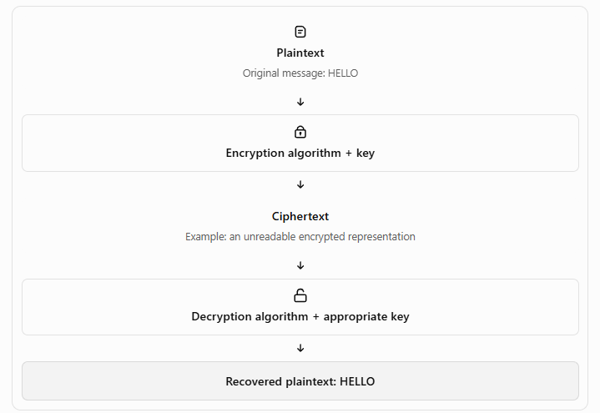
Basic cryptographic process

Slide 9
Types of cryptography
Cryptographic systems are commonly classified into symmetric-key cryptography, asymmetric-key cryptography, and cryptographic hash functions.
Symmetric-key cryptography
Asymmetric-key cryptography

Slide 10
Symmetric-key cryptography
Symmetric-key cryptography uses the same secret key, or closely related secret key material, for encryption and decryption.
The communicating parties must securely establish and protect the shared secret key.
Working:
The sender and receiver obtain a shared secret key.
The sender encrypts the plaintext using a symmetric algorithm.
The encrypted message is transmitted.
The receiver decrypts it using the shared key.

Slide 11

Symmetric-key cryptography
Examples:
AES (Advanced Encryption Standard)
ChaCha20
DES (Data Encryption Standard; now considered insecure for modern protection because its key is too short)
3DES (legacy algorithm, now deprecated for most modern uses)

Slide 12
Asymmetric-key cryptography
Asymmetric-key cryptography, also called public-key cryptography, uses a mathematically related pair of keys:
Public key: Can be shared with others.
Private key: Must be kept secret by its owner.
Examples:
RSA
Elliptic Curve Cryptography (ECC)
Elliptic Curve Diffie–Hellman (ECDH), for key agreement
Diffie–Hellman key exchange, a foundational method for establishing shared secrets

Slide 13
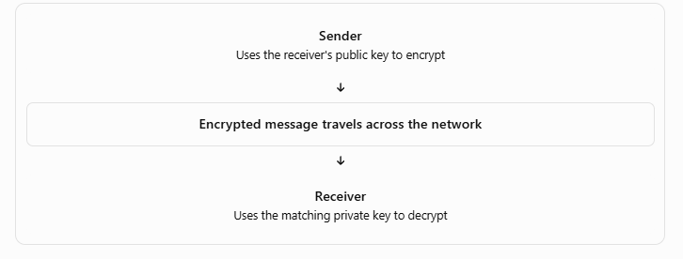
Asymmetric-key cryptography

Slide 14
Hash functions and message integrity
A cryptographic hash function transforms input data of arbitrary length into a fixed-length output called a hash value or message digest.
Unlike encryption, hashing is designed to be a one-way operation. A secure hash function should make it computationally infeasible to reconstruct the original message from its digest.
Examples: SHA-256 and SHA-3. MD5 and SHA-1 are considered unsuitable for applications requiring modern collision resistance.

Slide 15
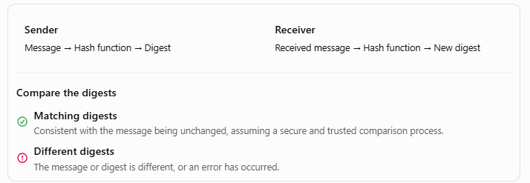
Hash functions and message integrity

Slide 16
Hash functions and message integrity
Working
The sender applies a hash function to the message.
A fixed-length digest is generated.
The receiver calculates the digest of the received message using the same hash function.
The receiver compares the locally calculated digest with the digest received through a trusted mechanism.
If they differ, the message or digest has changed, or a transmission or processing error has occurred.

Slide 17
Digital signatures
A digital signature is a cryptographic mechanism used to verify the authenticity and integrity of a digital message or document.
Working:
The sender calculates a digest of the message.
The sender signs the digest using a suitable digital-signature algorithm and the sender's private key.
The message and signature are sent to the receiver.
The receiver uses the sender's public key to verify the signature.
If verification succeeds, the receiver gains evidence that the signature corresponds to the message and the claimed signing key.

Slide 18
Digital signatures
Digital signatures support integrity, origin authentication, and evidence useful for non-repudiation.
Their strength depends on secure key management, correct verification, and reliable identification of the key owner.
Example: A software developer digitally signs a software release so users can verify that it came from the expected publisher and has not been altered since signing.

Slide 19
Firewalls
Definition
A firewall is a hardware device, software application, or combination of both that monitors and controls incoming and outgoing network traffic according to a defined security policy.
It establishes a controlled boundary between networks or security zones—for example, between an organization's internal network and the public Internet.
A firewall typically permits, rejects, or drops traffic based on rules involving addresses, protocols, ports, connection state, or application-level information.
Firewalls are an important part of network security, but they do not replace endpoint protection, authentication, patching, or other security controls

Slide 20
Why are firewalls required?
Organizations use firewalls to:
Prevent unauthorized connections to internal systems.
Restrict access to network services.
Control traffic entering and leaving the organization.
Segment networks and limit movement between security zones.
Record or monitor selected network events.
Reduce exposure to unwanted network traffic.
A firewall administrator defines rules specifying which connections are permitted and which must be blocked.
A secure configuration generally denies traffic that is not explicitly permitted by the applicable policy, while allowing necessary services.

Slide 21
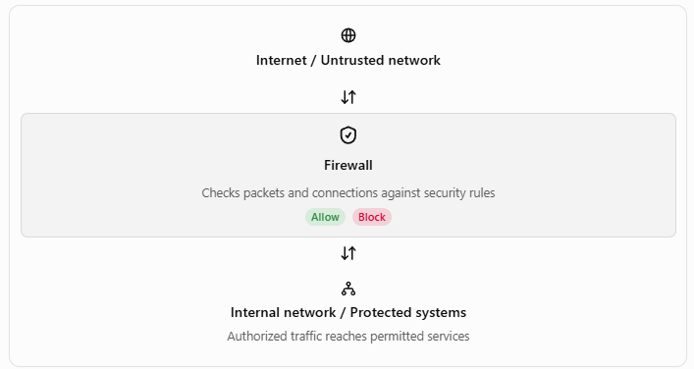
Basic firewall architecture

Slide 22
Types of firewalls
Packet-filtering firewall
A packet-filtering firewall examines individual packets and applies rules based on fields such as:
Source IP address.
Destination IP address.
Source and destination port numbers.
Transport protocol, such as TCP or UDP.
Direction of traffic.
It makes decisions using packet-header information without necessarily examining application content.

Slide 23
Types of firewalls
Example: A rule allows TCP traffic to a public web server on port 443 but blocks unsolicited external connections to an internal computer.
Advantages
Simple and efficient.
Low processing overhead.
Useful for basic traffic filtering.
Disadvantages
Basic stateless filtering does not track the context of a connection.
Limited ability to interpret application-layer behaviour.
Incorrectly configured rules may expose internal services.

Slide 24
Types of firewalls
Stateful inspection firewall
A stateful firewall tracks the state of network connections. It maintains a connection table and evaluates packets in the context of existing sessions.
For example, when an internal computer establishes an authorized TCP connection to a website, the firewall can allow the corresponding return traffic as part of that connection, according to its state and rules.

Slide 25
Types of firewalls
Advantages
More context-aware than basic stateless filtering.
Can distinguish expected return traffic from unrelated packets.
Useful for controlling connection-oriented traffic.
Disadvantages
Requires memory and processing to track connection state.
May be affected by resource exhaustion or implementation vulnerabilities.
Does not automatically detect all malicious application activity.

Slide 26
Types of firewalls
Application-level gateway (proxy firewall)
A proxy firewall acts as an intermediary between a client and a destination service. It can terminate one connection and create another, examining application-level requests before forwarding them.
For example, an organization's web proxy may enforce rules about which websites employees can access.

Slide 27
Types of firewalls
Advantages
Can inspect application-specific requests.
Can enforce detailed application policies.
Can help hide internal addressing and separate internal clients from external services.
Disadvantages
May introduce latency.
Requires suitable proxy support for the applications being controlled.
Encrypted traffic requires appropriate handling if deeper inspection is needed.

Slide 28
What firewalls cannot do
A firewall is not a complete security solution. It may not prevent:
Phishing attacks in which users voluntarily disclose credentials.
Malware introduced through permitted channels.
Attacks against vulnerable applications exposed through allowed ports.
Insider misuse of authorized access.
Attacks through misconfigured rules or compromised devices.
All malicious activity hidden within encrypted traffic.
A layered security approach combines firewalls with endpoint security, secure authentication, software updates, monitoring, backups, and user awareness.

Slide 29
Virtual Private Networks (VPNs)
Definition
A Virtual Private Network (VPN) is a technology that establishes a protected logical connection across an existing network, such as the public Internet.
A VPN can connect a remote user to an organization's private network or securely connect two geographically separated networks. Depending on the VPN technology, it can provide encryption, authentication, integrity protection, and tunnelling.
A VPN does not necessarily provide all these services by itself; the specific protocol and configuration determine the protection offered.

Slide 30
Why are VPNs required?
Organizations may have offices, employees, servers, and resources distributed across different locations. Using dedicated private communication links between every location can be expensive.
VPNs use existing network infrastructure to establish protected communications.
Common applications include:
Remote access to office applications and files.
Secure connections between branch offices.
Access to internal academic or corporate systems while travelling.
Protection of network traffic over untrusted networks.
Secure connectivity between cloud environments and organizational networks.

Slide 31
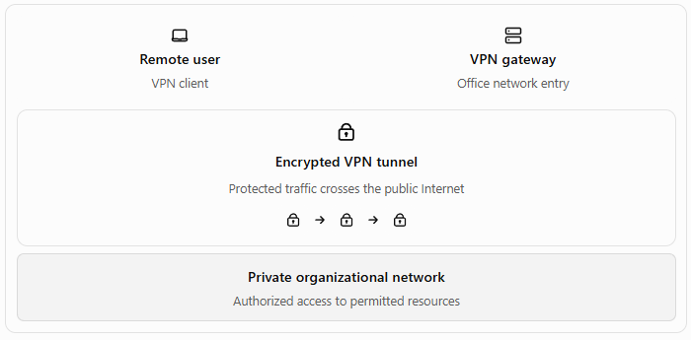
How a VPN works
A VPN commonly uses tunnelling to carry traffic through an existing network. Where encryption is supported and correctly configured, the original traffic is protected before being transmitted through the tunnel.

Slide 32
How a VPN works
Step-by-step operation
The user starts a VPN client or connects through a supported VPN device.
The client and VPN gateway establish a connection using the selected VPN protocol.
The parties authenticate as required by the configuration.
Cryptographic keys and security parameters are established.
The VPN encapsulates traffic into tunnel packets and applies encryption and integrity protection when supported.
The protected traffic crosses the public network.
The VPN gateway verifies and decapsulates the traffic, then forwards authorized traffic toward the destination.
Return traffic travels through the VPN according to the configured routing and security policies.
Important: A VPN does not make every destination or application automatically secure. Access controls, endpoint security, DNS configuration, routing, and the VPN provider or organization's policies still matter.

Slide 33
Types of VPNs
Remote-access VPN
A remote-access VPN allows an individual user or device to connect securely to an organization's private network from a different location.
Example: A faculty member working from home connects to the college VPN to access an internal academic server.
Characteristics:
Connects an individual device to a private network.
Commonly uses client software or an operating-system VPN client.
Requires user or device authentication.
Can restrict access according to the user's role.

Slide 34
Types of VPNs
Site-to-site VPN
A site-to-site VPN connects two or more networks through VPN gateways.
It is commonly used to connect branch offices to headquarters.
Example: A college's main campus and a remote campus securely exchange data over the Internet.
Two common configurations are:
Intranet VPN: Connects sites belonging to the same organization.
Extranet VPN: Connects an organization to an authorized external organization, such as a business partner.

Slide 35
Types of VPNs
Host-to-host VPN
A host-to-host VPN establishes a protected connection between two individual computers or servers.
It can be useful when two particular systems need a protected channel without connecting entire networks.

Slide 36
Advantages of VPNs
Provides protected communication over untrusted networks when properly configured.
Supports secure access to private organizational resources.
Can reduce the cost of connecting geographically separated locations.
Helps protect sensitive traffic from network eavesdropping.
Supports centralized access policies and authentication.

Slide 37
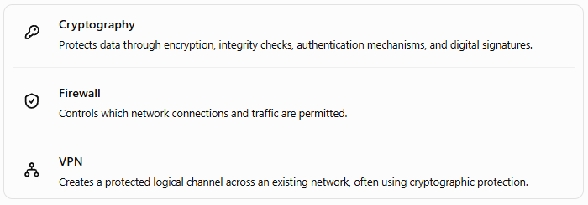
How Cryptography, Firewalls, and VPNs Work Together
These three technologies address complementary aspects of network security.

Slide 38
How Cryptography, Firewalls, and VPNs Work Together
Real-world example: College network
Suppose a faculty member needs to access an internal college server from home.
The faculty member authenticates to the college's remote-access VPN.
The VPN uses cryptographic protocols to establish a protected tunnel.
The college firewall checks whether the user and connection are permitted to access the internal server.
The server applies its own authentication and authorization rules.
Network monitoring records relevant security events.
In this scenario, the VPN protects the communication channel, cryptography supports confidentiality and integrity, and the firewall restricts network access. All three contribute to security, but none replaces the others.

Slide 39
Security Protocols: SSL/TLS and IPsec
Introduction to Security Protocols
A security protocol is a set of rules that defines how communicating systems establish trust, authenticate parties, protect information, and exchange data securely over a network.
When information travels across the Internet, an attacker may attempt to intercept, modify, replay, or impersonate network traffic. Security protocols use cryptographic algorithms and communication procedures to defend against these threats.

Slide 40
Security Protocols: SSL/TLS and IPsec
Two important security technologies are:
SSL/TLS: Protects communication between applications, such as a web browser and a web server.
IPsec: Provides security at the Internet Protocol (IP) layer and is widely used to build VPNs.
Although both use cryptography, they operate at different layers and are designed for different communication needs.

Slide 41
Objectives of security protocols
Objective | Description
Confidentiality | Prevents unauthorized parties from reading protected data.
Integrity | Helps detect unauthorized modification of data.
Authentication | Verifies the identity of a communicating party or the origin of data.
Anti-replay protection | Helps prevent attackers from capturing and replaying previously transmitted protected packets or messages.
Key establishment | Enables communicating parties to establish cryptographic keys securely.

Slide 42
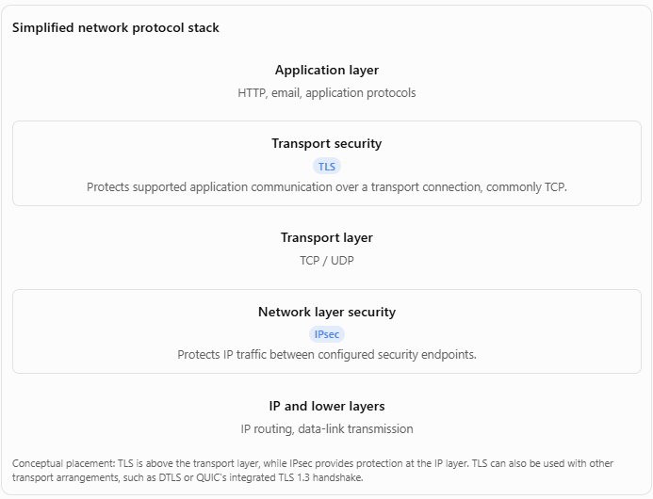
Where SSL/TLS and IPsec operate

Slide 43
SSL (Secure Sockets Layer)
Secure Sockets Layer (SSL) is a cryptographic protocol originally developed to secure communication between applications over a network. It became widely known through its use in securing web traffic.
SSL was designed to provide:
Confidentiality through encryption.
Message integrity.
Authentication, especially server authentication using certificates.
However, SSL versions have serious known security weaknesses and are obsolete. SSL 2.0 and SSL 3.0 must not be used in modern secure deployments.
Important: SSL is now mainly a historical term. Modern secure web communication uses TLS, the successor to SSL.

Slide 44
Why was SSL introduced?
In early web communication, HTTP traffic was generally transmitted without cryptographic protection. An attacker positioned along the communication path could potentially read or modify the information.
For example, when a user submitted login credentials through an unprotected HTTP connection, those credentials could be exposed to network interception.
SSL was introduced to create a secure channel between a client and a server, allowing data to be encrypted and authenticated.

Slide 45
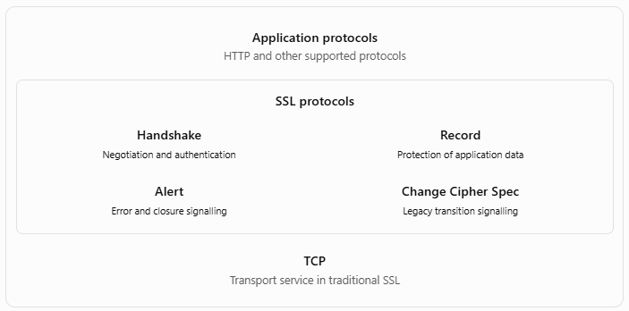
SSL architecture

Slide 46
Components of SSL
Handshake Protocol
  The Handshake Protocol allowed the client and server to negotiate cryptographic parameters, authenticate the server, and establish shared secret key material.
Record Protocol
  The Record Protocol handled application data and certain SSL control messages. It provided confidentiality and integrity according to the negotiated cipher suite.
Alert Protocol
  The Alert Protocol communicated errors and connection-closure information.
Change Cipher Spec Protocol
  In legacy SSL and early TLS designs, this message signalled a change to the negotiated protection state. It has a much more limited role in modern TLS.

Slide 47
TLS (Transport Layer Security)
Transport Layer Security (TLS) is a cryptographic protocol that provides secure communication between applications over a network. It evolved from SSL and is standardized by the Internet Engineering Task Force (IETF).
TLS is widely used in HTTPS, secure APIs, email transport protection, and many other application protocols.
TLS aims to provide:
Confidentiality: Application data is encrypted.
Integrity: Unauthorized modification of protected records can be detected.
Authentication: Certificates or other supported credentials can verify the communicating parties.
Secure key establishment: The parties derive session keys for protecting data.

Slide 48
TLS Architecture and Working
TLS connection architecture
  TLS usually operates between an application protocol and a reliable transport protocol such as TCP. HTTPS uses HTTP protected by TLS.
  For example, when a user visits https://example.com, the browser establishes a TLS connection with the server before exchanging protected HTTP application data.
  The main TLS components in TLS 1.2 include the Handshake Protocol, Record Protocol, Alert Protocol, and Change Cipher Spec mechanism.
  TLS 1.3 simplifies and changes several aspects of the earlier architecture, so legacy SSL/TLS diagrams should not be interpreted as applying unchanged to TLS 1.3.

Slide 49
TLS handshake process
The TLS handshake establishes the security parameters for communication. Depending on the TLS version and configuration, it negotiates cryptographic algorithms, authenticates the server, establishes shared key material, and may authenticate the client.
Simplified TLS 1.3 handshake

Slide 50
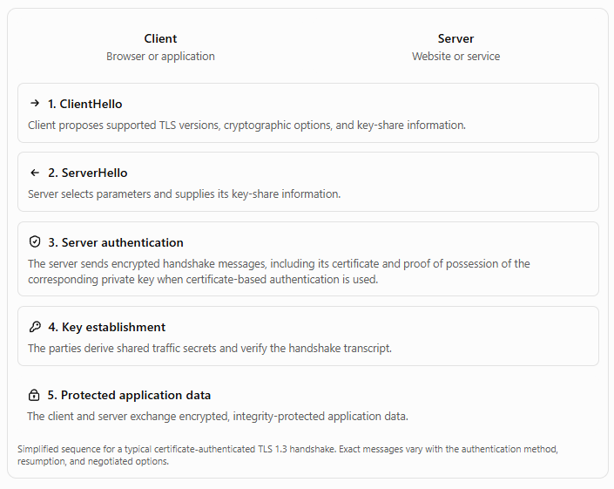
Simplified TLS 1.3 handshake

Slide 51
Simplified TLS 1.3 handshake
Step 1: ClientHello
The client sends a ClientHello message containing supported TLS versions, cryptographic capabilities, and key-share information. It may also identify the intended server name through the Server Name Indication (SNI) extension.
Step 2: ServerHello
The server selects compatible parameters and responds with its ServerHello message and key-share information.

Slide 52
Simplified TLS 1.3 handshake
Step 3: Key derivation
The client and server use the negotiated key-establishment mechanism, commonly ephemeral Diffie–Hellman, to derive shared secret material. In TLS 1.3, the key schedule derives separate traffic secrets for different communication directions and stages.
Step 4: Server authentication
The server typically sends a digital certificate containing its public key and identity information, followed by proof that it possesses the corresponding private key. The client validates the certificate chain, hostname, validity, and other applicable requirements.

Slide 53
Simplified TLS 1.3 handshake
Step 5: Finished messages
The communicating parties verify the handshake transcript using cryptographic authentication. This helps detect tampering with the handshake messages.
Step 6: Application data transfer
After the handshake reaches the required state, the client and server exchange application data protected using the derived traffic keys.

Slide 54
IPsec (Internet Protocol Security)
IPsec is a suite of protocols that provides security services at the IP layer. It can protect IP packets travelling between two hosts, between two security gateways, or between a host and a security gateway.
IPsec is widely used to implement VPNs, especially site-to-site VPNs connecting organizational networks across the Internet.
IPsec can provide:
Confidentiality.
Data integrity.
Data-origin authentication.
Anti-replay protection.
Access control through security policies.
The exact services depend on the IPsec protocol, mode, algorithms, and configuration.

Slide 55
Why is IPsec required?
IP is primarily responsible for addressing and routing packets. Ordinary IP traffic does not inherently encrypt its contents or authenticate its source.
For example, a company may need to exchange internal database traffic between two offices over the public Internet. Without an appropriate security mechanism, sensitive information could be exposed or altered along the path.
IPsec can protect IP traffic between configured endpoints without requiring every application to implement its own encryption.

Slide 56
IPsec architecture
The main IPsec components are:
Authentication Header (AH): Provides integrity, data-origin authentication, and anti-replay support where configured, but not confidentiality.
Encapsulating Security Payload (ESP): Can provide confidentiality, integrity, data-origin authentication, and anti-replay protection.
Internet Key Exchange (IKE): Negotiates security parameters and establishes keys used by IPsec.
Security Association (SA): Defines the security parameters used to protect traffic in one direction.
ESP is the commonly used protocol for modern IPsec VPN deployments.

Slide 57
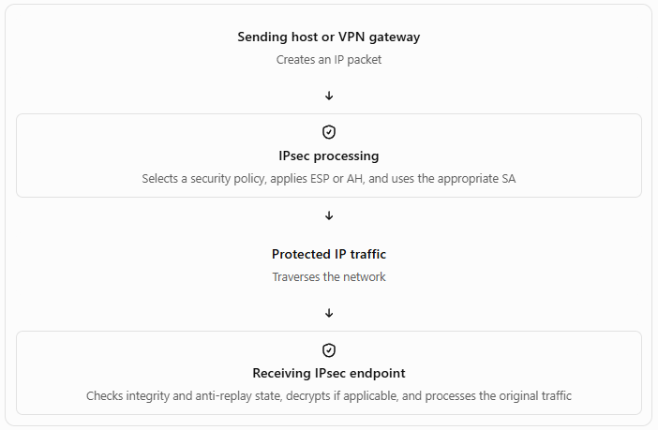
Basic IPsec operation

Slide 58
Basic IPsec operation
Step-by-step explanation
The sender's IPsec policy determines whether the traffic should be protected.
The appropriate Security Association (SA) supplies the security parameters, algorithms, and keys.
IPsec applies ESP or AH according to the configuration.
The protected packet is transmitted across the network.
The receiving endpoint identifies the applicable SA.
It checks packet integrity and anti-replay information, and decrypts the packet if ESP confidentiality is enabled.
The receiving endpoint forwards the recovered packet or delivers its contents to the appropriate processing layer.

